Slide 1


Objectives
In this session, you will learn to:
  Work with styles

Slide 2
Styling HTML Elements
The list properties:
  Are used to customize the look of the ordered and unordered HTML lists.
  Are of the following types:
    Use the animation, HTML_02_StylingLists.swf, to understand the
    concept of styling lists.
list-style-position
list-style-type
list-style
list-style-image

Slide 3
Styling HTML Elements (Contd.)
The background properties:
  Are used to specify the background color, image, or position of the HTML elements.
  Are of the following types:
background-color
background-image
background

Slide 4
Grouping and Nesting Styles
Styles are grouped:
  To apply the same styles on more than one selector.
  Using the following syntax:
    selector1, selector2
    {
    property:value;
    }

Slide 5
Grouping and Nesting Styles (Contd.)
Styles are nested:
  To apply style on an element within another element.
  To discard the usage of class or ID selectors in the code.
  In the following ways:
Selector | Example | Description
element1>element2 | div>p | Selects all the <P> elements, where <DIV> is the parent element.
element1 element2 | div p | Selects all the <P> elements inside the <DIV> element.
element1 + element2 | div+p | Selects all the <P> elements that are placed immediately after the <DIV> element.
element1 ~ element2 | div~p | Selects every <DIV> element that is preceded by the <P> element.

Slide 6
Controlling the Visibility of Elements
The CSS visibility styles can be applied on the HTML elements using the
following properties:
  display
  visibility

Slide 7
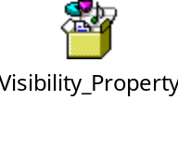
Controlling the Visibility of Elements (Contd.)
The display property:
  Is used to set the appearance of an element on a Web page.
  Can be applied using the following syntax:
display: none| block| inline
The visibility property:
  Is used to specify whether an element should be visible or not.
  Can be applied using the following syntax:
    visibility: hidden| visible
    The following embedded Notepad file contains the code to show the use of visibility
    property:

Slide 8
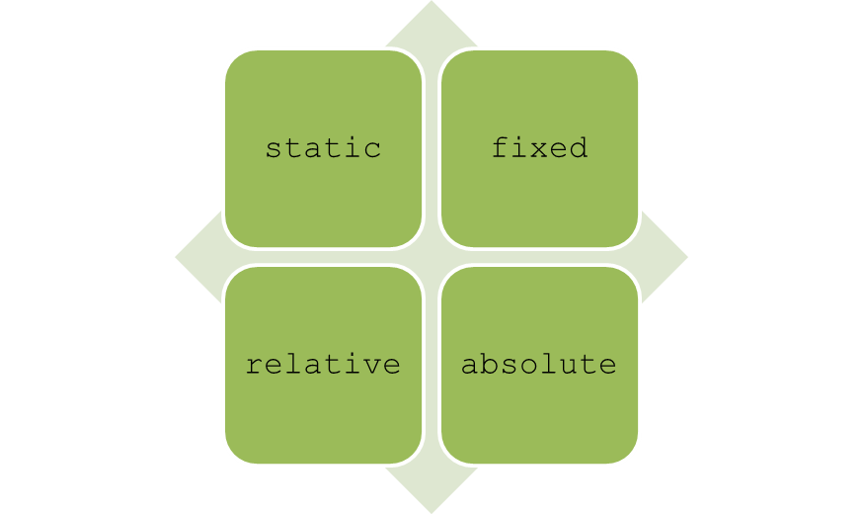
Positioning HTML Elements
CSS positioning properties:
  Are used to control the placement of elements on a Web page.
  Can be classified into the following categories:
    position
    float
  The position property is used to position an element on a Web page using the
  following positioning methods:

Slide 9
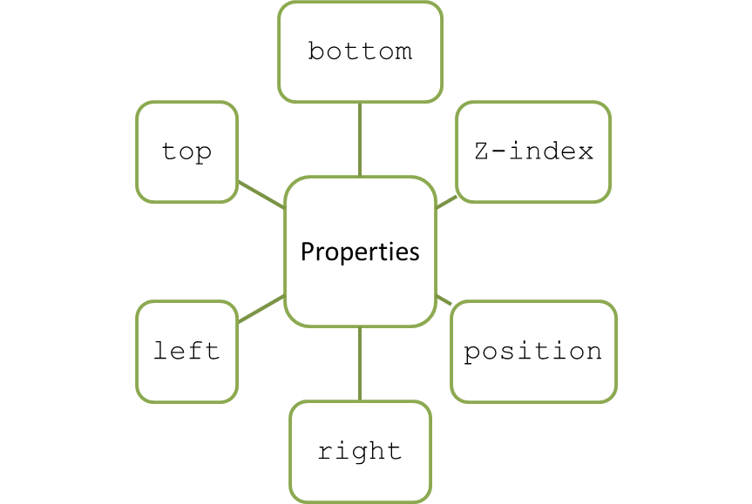
Positioning HTML Elements (Contd.)
The exact location for the HTML elements can be specified using the following
positioning properties:
  Use the animation, HTML_02_Positioning.swf, to understand the concept
  of CSS positioning.

Slide 10

Positioning HTML Elements (Contd.)
The float property:
  Is used to place HTML elements to the left or right margin, in relation to
  other elements.
  Allows you to wrap the HTML elements around the floated element.
  Can be specified by using the following syntax:
    float: left|right|none
    The following embedded Notepad file contains the code to show the use of float property:

Slide 11

Positioning HTML Elements (Contd.)
The clear property:
  Is used to turn off the float effect on HTML elements.
  Can be specified by using the following syntax:
    clear: both|left|right;
    The following embedded Notepad file contains the code to show the use of clear
    property:
    Use the animation, HTML_02_Floating.swf, to understand the concept of
    float and clear properties.

Slide 12
Just a Minute
Which one of the following style sheets is used when multiple pages need to be
styled in the same manner?
  Internal style sheet
  Inline style
  External style sheet
  Browser default

Slide 13
Just a Minute (Contd.)
Solution:
  External style sheet

Slide 14
Demo: Implementing Styles on HTML Elements
Problem Statement:
  Steve has developed the home page for ShowOnWheels. Now, he needs to enhance the look and feel of this home page. For this, he needs to apply the following styles:
    The Web page should contain the background image.
    The logo of ShowOnWheels should appear at top of the Web page.
    The links should appear horizontally.
    The links should be displayed in pink color at the time of activation.
    The paragraph text should appear in different font styles.
    The list should appear with filled circles before the list items.
  Help Steve to perform the preceding tasks.
  Prerequisite: You need to use the ShowOnWheels file to perform this activity. In addition, you need the background.gif file. Ask your faculty to provide you the same.

Slide 15
Demo: Implementing Styles on HTML Elements (Contd.)
Solution
  To implement styles on a Web page, you need to perform the following tasks:
    1. Create an external style sheet.
    2. Link the style sheet in the home.html file.
    3. View the home page.

Slide 16
Summary
In this session, you learned that:
  The list properties are used to customize the look of the ordered and unordered HTML lists.
  The background properties are used to specify the background color, image, or position of the HTML elements.
  In CSS, the styles are grouped to apply the same styles on more than one selector.
  Styles are nested to apply style on an element within another element.
  The display property is used to set the appearance of an element on a Web page.
  The visibility property is used to specify whether an element should be visible or not.
  CSS positioning is used to position an element on a Web page.
  The float property is used to place HTML elements to the left or right margin, in relation to the other elements.
  The clear property is used to turn off the float effect on HTML elements.

